Slide 1
Part II
Notes:
Facilitator:
The purpose of Part II is to go more deeply into the philosophies and values of our district. We examine how to apply the philosophy, generally using local resources and interviews of past and present leaders.

Slide 2
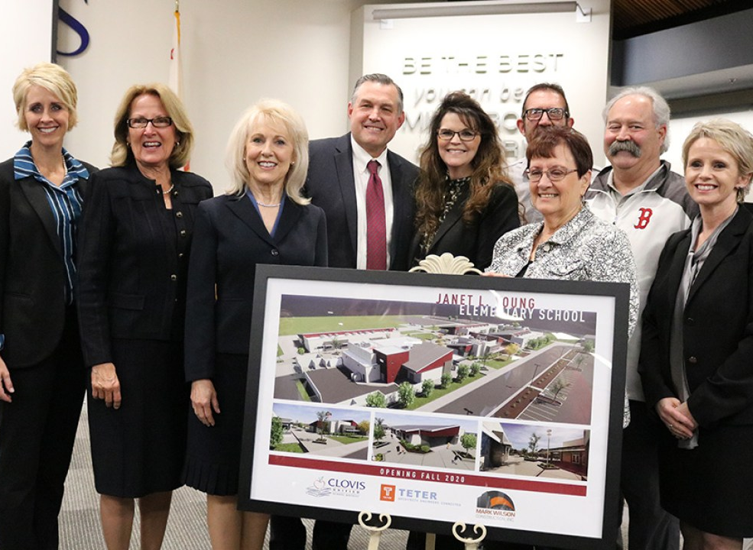
Be visible and be present.
“When I started working at Clovis Unified my desk was out in the open, and Janet Young was superintendent. Every time she saw me or walked by my desk she would stop, she would say hello to me, and she would ask me, by name, about my wife and children.”
Danny Cobb
Notes:
Script: Tiers I, II, III
Facilitator:
Let’s read the quote from Danny Cobb. Danny not only attended Clovis schools but is now an employee in our Business department. You can tell from his quote that he felt a connection to Janet because of her efforts to be visible and present. Janet was the first female Superintendent in Clovis Unified. One of her greatest strengths is her ability to lead through relationship. If you don’t know Janet, she is third from the left. You also see Board members and Dr. O’Brien presenting Janet with a rendering of Janet Young Elementary School.
In a small group read the quote and discuss one or more of the following (facilitator’s choice):
101 - What does being visible and present look like? Be specific and use examples.
201 - As a leader discuss ways you show your employees, students, parents and community members that you are present? For instance, not checking your cell phone when talking with someone.
301 - What do you see and hear people saying and doing that demonstrates they are visible? Again, be specific and provide examples.
Ask each group to share one-two responses.

Slide 3
People need to know you care, and that they matter.
“No one cares how much you know until they know how much you care.”
Theodore Roosevelt
“Never believe that a few caring people can’t change the world. For, indeed, that’s all who ever have.”
Margaret Mead
“To be successful is to be helpful, caring, and constructive, to make everything and everyone you touch a little bit better.” Norman Vincent Peale
Notes:
Script: Tiers I, II, III
Facilitator:
The quotes on the screen all center around the value people need to know you care, and that they matter. Chose one quote on the screen that resonates with you and explain why to your neighbor.
Discussion Points:
In small job alike groups discuss the quotes on the screen and answer one or more (facilitator choice) the following questions:
101 – How do the three quotes relate to the value people need to know you care, and that they matter?
201 – When, in your career and/or life have you realized “no one cares how much you know until they know how much you care?” Describe the situation to members of your group.
301 – Read the quote by Norman Vincent Peale, who wrote the book The Power of Positive Thinking. Does his definition of success align to yours? Explain how it does or doesn’t. What is your definition of success?
Ask each group to share a quote and explain why they chose that quote. Ask for one takeaway from the questions discussed.

Slide 4
Everyone in the organization is here to serve kids.
“Whether you are a teacher, administrator, custodian, secretary, maintenance person, cafeteria employee, paraprofessional or someone in human resources. It's all connected with providing support services the teacher in the classroom needs to be a successful teacher. Whatever job you’re involved in, is very important. They all have different responsibilities, but the focus should be, we're all here to do what's good for kids.”
Terry Bradley, Ed.D.
Notes:
Script:
Facilitator:
I love this quote from former Superintendent Terry Bradley. Terry came from the Business side of the house. In this quote he drives home one of the cornerstone values of our district, everyone is here to serve kids. With this in mind let’s spend a little time discussing various positions and how they support student success.
Discussion Points:
Working with a partner discuss one or more (facilitator’s choice) of the following;
101 – Think about the department/school site at which you work? What do you see employees doing to support students? Use examples to explain your answer.
201 – Name 5 departments in our district. Explain how each department contributes to student success? Use examples to explain your answer.
302 – Identify ways, you as a leader, can make sure all employees feel connected to students and responsible for their success.
Ask for volunteers to share key take-aways.

Slide 5
Take the time to deliver important news in person.
Notes:
Script:
Facilitator:
In the video you heard Dr. Dan Kaiser talk about his experience at Clovis West when his brother was killed. You can sense from the video what a tough experience this was for Dan but also how much he appreciated the care he received from a colleague. If the facilitator has a similar story, please share. Let’s spend some time thinking about the value take time to deliver important news in person.
There have been several times in our history that a leader has pulled us together to deliver important news. Examples:
I remember a colleague telling me that Rene Errotabere called her at home immediately after the Board released our Superintendent..
Another colleague shared that Janet called the leadership team together, on the weekend, to share the news of an employee arrest for child molestation before it broke in the news.
Discussion Points:
In a group of 3 discuss one or more of the following (facilitator’s choice):
101 – What kind of news should be deemed so important that you, as a leader, need to deliver it in person? Provide examples.
202 – Has there been a time on your campus or in your department that you or another leader needed to pull everyone together to deliver important news? Explain the situation and how it was handled. Be specific.
303 – Does your site/department have plan in place when you need to get important news out but cannot deliver it in person? Explain your procedure.
Ask each group to share one of their answers.

Slide 6
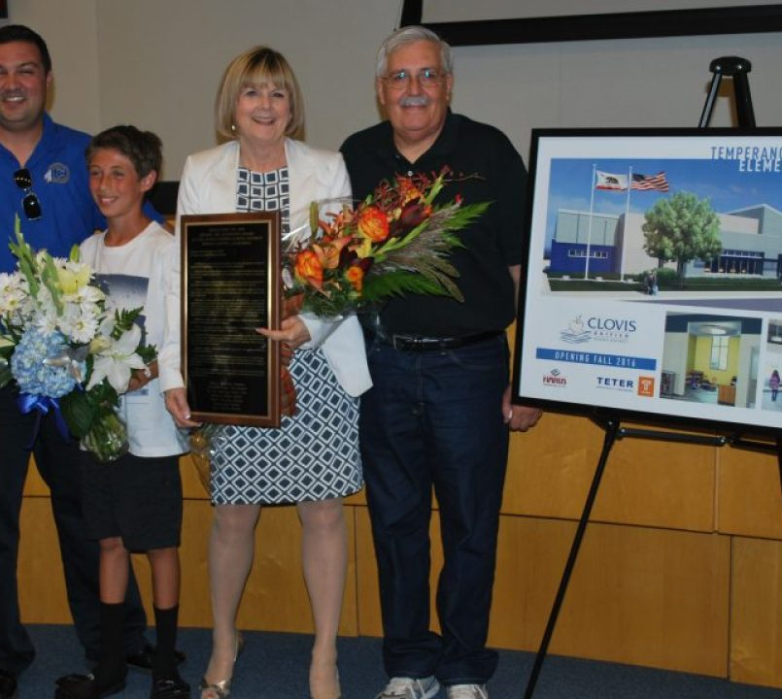
Build teamwork and trust through relationships
When you are leading, you are the district. You must build trust and give people a voice. What does that mean? What does it look like? It means that I give people an opportunity to speak out and be heard without being criticized.
Virginia Boris, Ed.D.
Notes:
Script
Facilitator:
There are several leaders, both past and present, in our district who serve as examples of the philosophy build teamwork and trust through relationships. Dr. Virginia Boris is one of those leaders, If you don’t know Ginny she is the only woman in the picture on the screen. This was taken the night the governing Board presented her with a rendering of the Virginia Boris Elementary School. Next to her is her husband, Ron, son Nick, and grandson.
Take a minute to read the quote on the screen. In CUSD we believe that you have to build trust and at the same time you have to give people a voice, but what does that look like. I once had an administrator tell me that just because I didn’t hear complaints or concerns didn’t mean that the didn’t exist. Without giving people a voice and them feeling safe to share their voice we cannot build relationships. Please form a triad so we can discuss what it means to build trust.
Discussion Points:
101- In CUSD what systems are in place to ensure students, employees, and community members are heard? Use examples to illustrate your answer.
201 – In your department or school site identify the systems you have in place for employees and/or students to be heard. Explain how it works.
301 – Reflect on the systems you have in place that allow you to build teamwork and trust in your current leadership role. Which systems are working well and which can be improved upon. Be specific and use examples.
After discussion ask each triad to share their responses with the larger group.

